Slide 1



{{CUSTOM_SLIDE_1}}
{{CUSTOM_SLIDE_1}}
{{CUSTOM_SLIDE_1}}

Slide 2


{{CUSTOM_SLIDE_2}}
{{CUSTOM_SLIDE_2}}
{{CUSTOM_SLIDE_2}}
{{CUSTOM_SLIDE_2}}
{{CUSTOM_SLIDE_2}}
{{CUSTOM_SLIDE_2}}
{{CUSTOM_SLIDE_2}}
{{CUSTOM_SLIDE_2}}
{{CUSTOM_SLIDE_2}}
{{CUSTOM_SLIDE_2}}
{{CUSTOM_SLIDE_2}}
{{CUSTOM_SLIDE_2}}
{{CUSTOM_SLIDE_2}}
{{CUSTOM_SLIDE_2}}
{{CUSTOM_SLIDE_2}}

Slide 3

{{CUSTOM_SLIDE_3}}
{{CONTENT_SLIDE_3}}
{{CUSTOM_SLIDE_3}}

Slide 4

{{CUSTOM_SLIDE_4}}
{{CUSTOM_SLIDE_4}}
{{CUSTOM_SLIDE_4}}
CVViZ: An AI-powered tool that contextually screens resumes, automating candidate sourcing and matching the right candidates to the right jobs.
Freshteam: Extracts complex data from resumes to create enriched candidate profiles, streamlining the hiring process.
Trakstar Hire: Offers automated resume parsing and candidate ranking to help recruiters identify top talent efficiently.
{{CUSTOM_SLIDE_4}}
{{CUSTOM_SLIDE_4}}

Slide 5

{{CUSTOM_SLIDE_5}}
Recruiting talent is challenging and time-consuming for HR teams.
HR professionals spend excessive time manually reviewing large volumes of resumes.
This manual process makes it difficult to identify the best candidates quickly.
It is also inefficient and prone to human bias and error.
Job seekers often face delays in receiving timely feedback on their resumes.
This leads to uncertainty about job eligibility and missed opportunities.
The lack of automation in the recruitment process causes delayed decisions and overall inefficiencies for both recruiters and candidates.
{{CUSTOM_SLIDE_5}}

Slide 6
{{CUSTOM_SLIDE_6}}
{{CUSTOM_SLIDE_6}}
{{CUSTOM_SLIDE_6}}

Slide 7
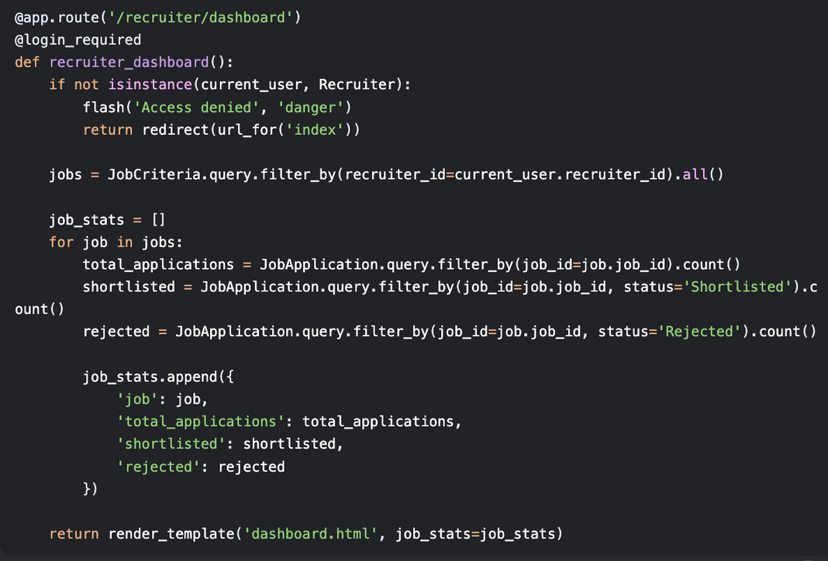
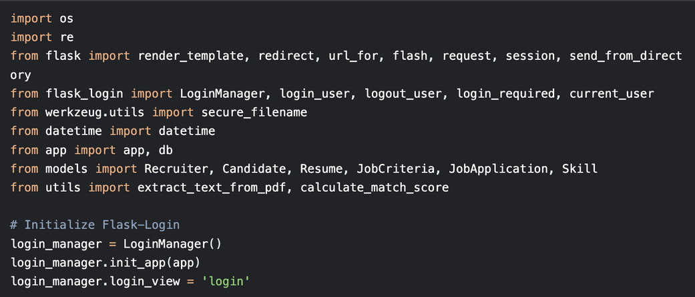
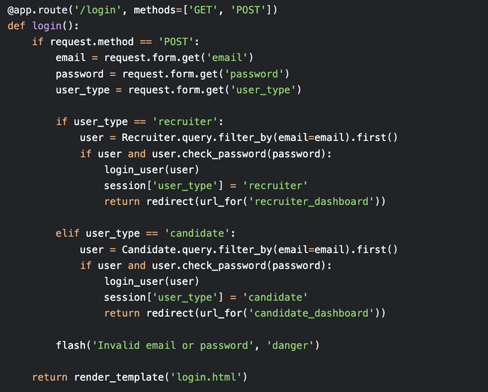
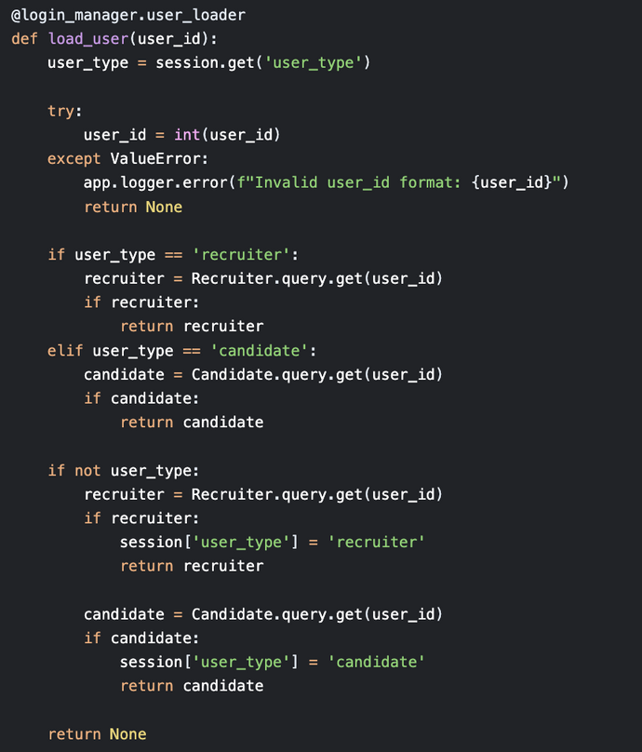
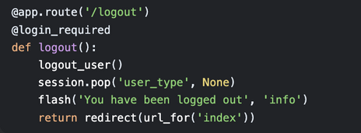
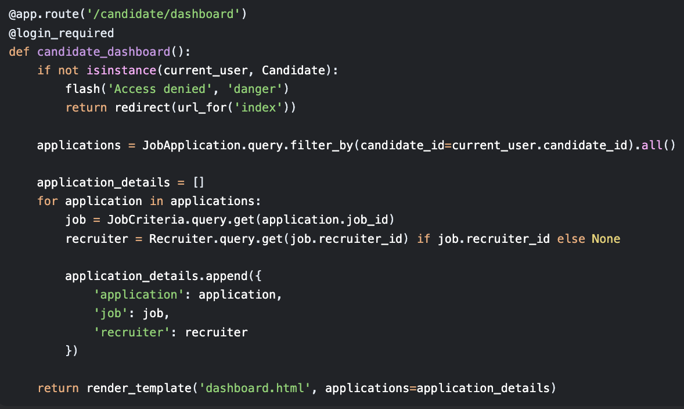
{{HEADER_SLIDE_7}}
{{CUSTOM_SLIDE_7}}

Slide 8
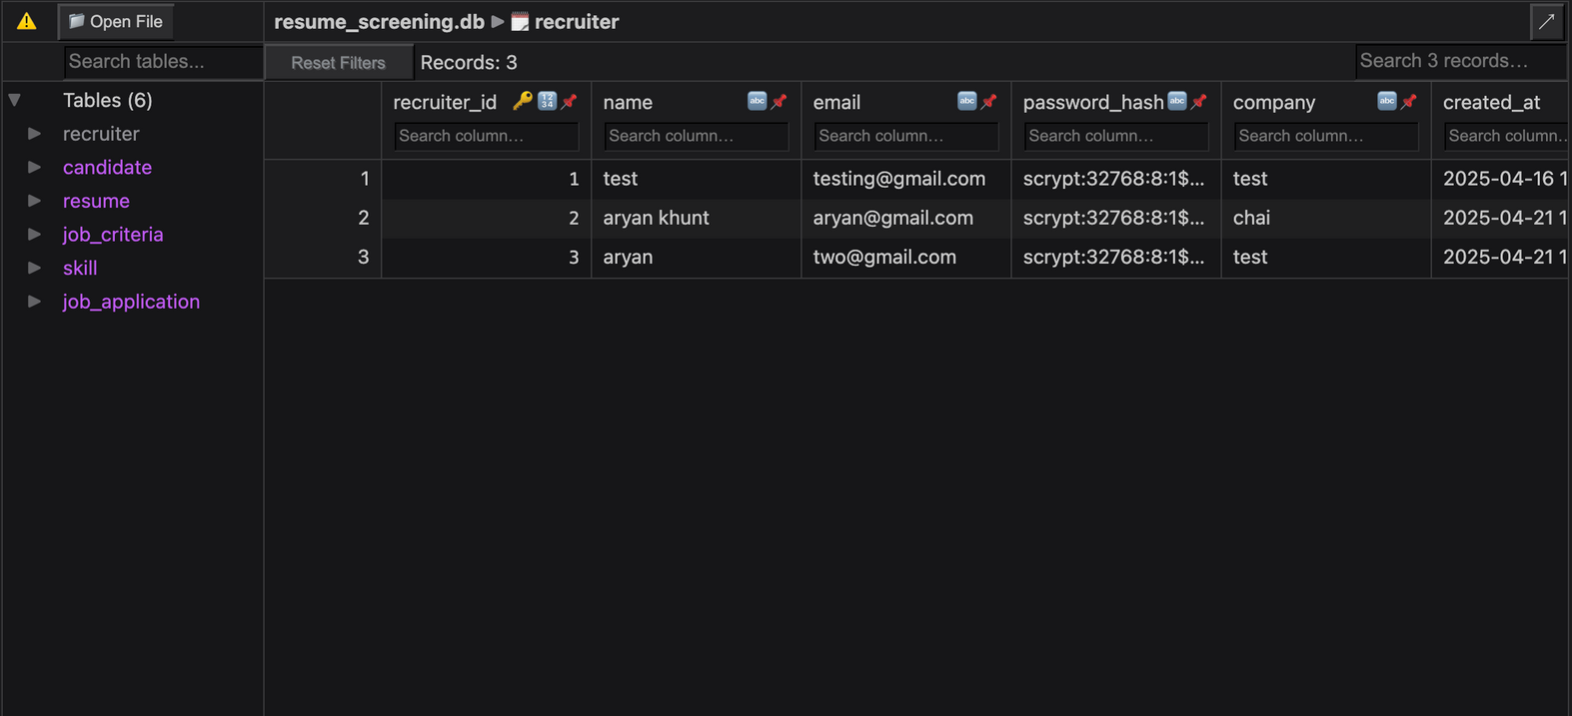
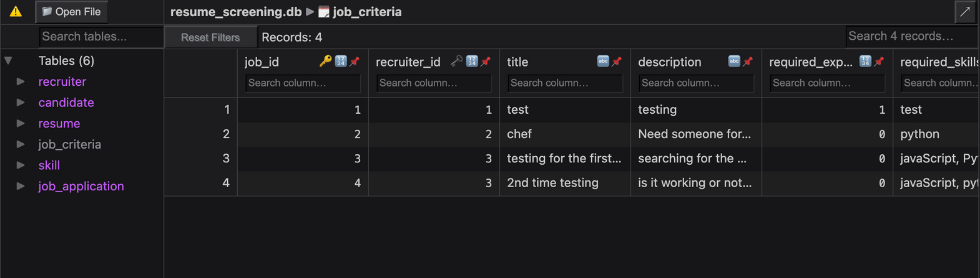
{{HEADER_SLIDE_8}}
{{CUSTOM_SLIDE_8}}

Slide 9
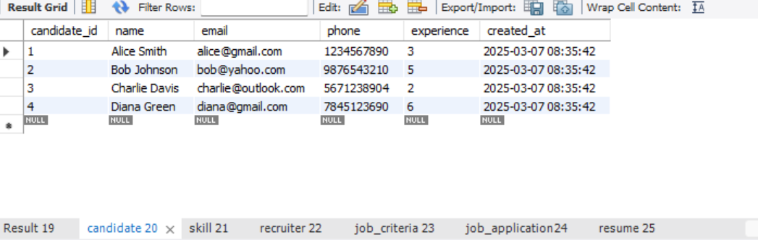
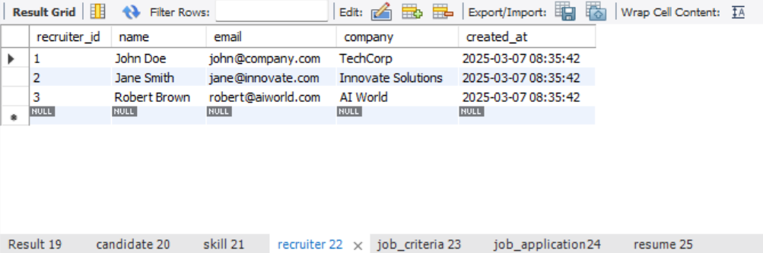
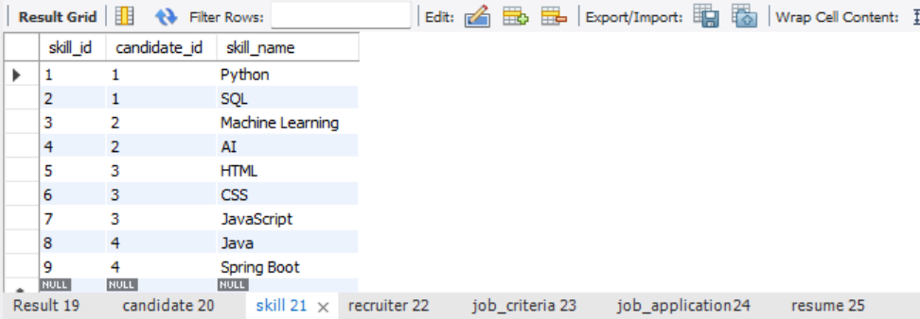
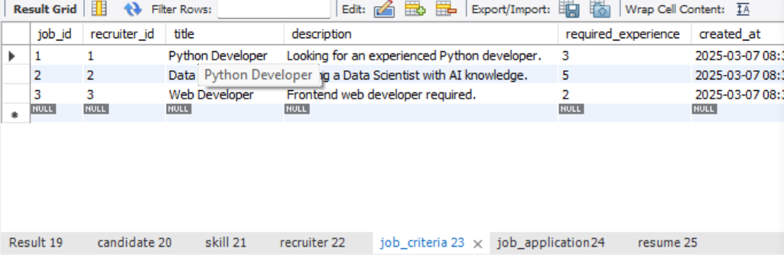
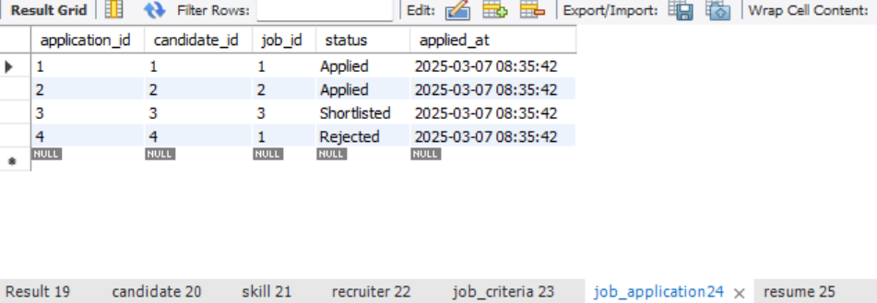
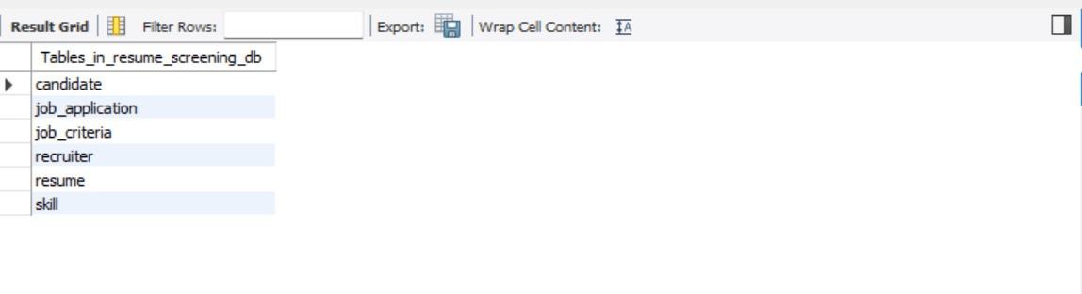
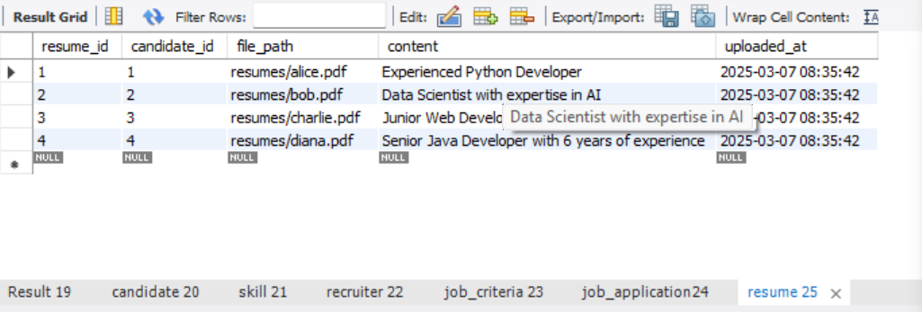
{{HEADER_SLIDE_9}}
{{CUSTOM_SLIDE_9}}

Slide 10
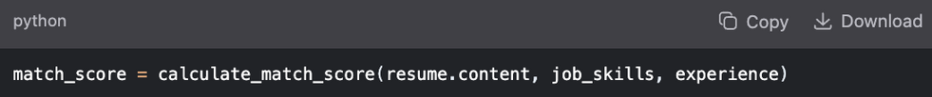
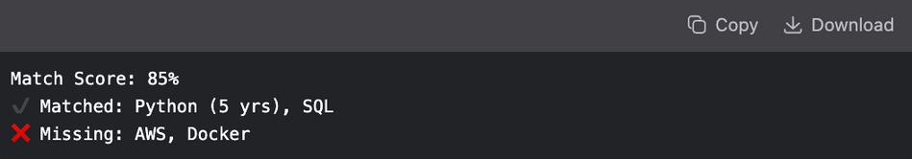
{{CUSTOM_SLIDE_10}}
{{CUSTOM_SLIDE_10}}
{{CUSTOM_SLIDE_10}}
{{CUSTOM_SLIDE_10}}
{{CUSTOM_SLIDE_10}}
{{CUSTOM_SLIDE_10}}
{{CUSTOM_SLIDE_10}}

Slide 11

{{CUSTOM_SLIDE_11}}
{{CUSTOM_SLIDE_11}}

